Slide 1

Version control with git
Kostas Sofos

Slide 2


Git
What?
Distributed version control software
Fast
Free
Cross platform
Open-source
Created by Linus Torvalds in 2005
Notes:
Δημιουργήθηκε το 2005 από τον μπαμπά του Linux (Linus Torvalds)
Αποτελεί το κυρίαρχο distributed version control software
Έχει πολλά πλεονεκτήματα. Είναι fast free cross-platform και open source

Slide 3
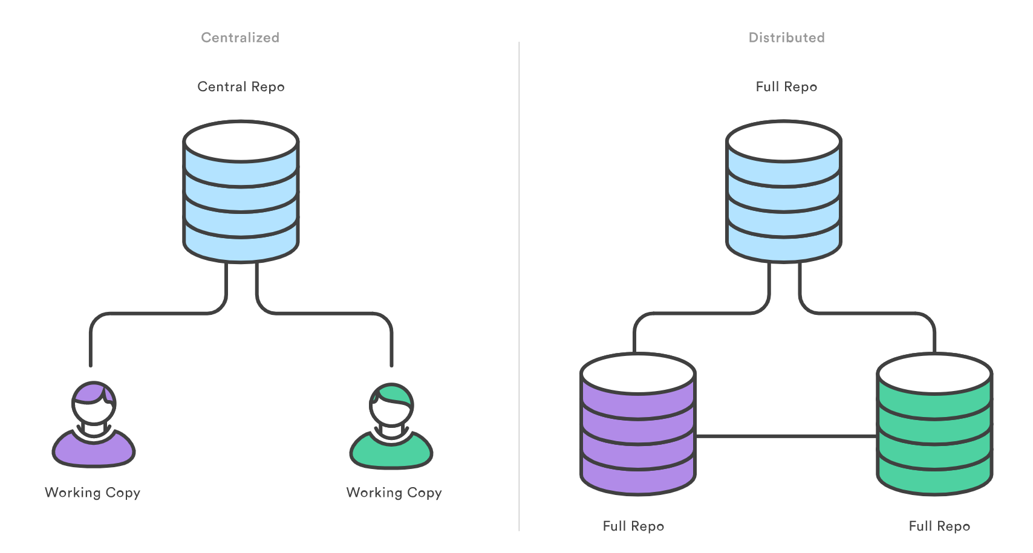
Git
Why?
Reliable
Fast (again)
Cheap branching
Easy to merge
Flexible
Distributed development
Notes:
Οι αλγόριθμοι που χρησιμοποιεί για να κάνει το file diffing είναι πολύ γρήγοροι.
Η δημιουργία branches είναι εξαιρετικά γρήγορη / φτηνή (Pointers to commits, not full source copy)
Merge: Η διαδικασία της μεταφοράς αλλαγών μεταξύ δύο branches
Αποτελεσματικοί αλγόριθμοι στη διαχείριση των conflicts
Εύκολη διαδικασία επίλυσης τους
Ευπροσάρμοστο. Προσφέρει διάφορα μοντέλα μη-γραμμικής ανάπτυξης άσχετα με το μέγεθος των projects.

Slide 4



Git basics
Git clients
Visual Studio
Vs Code
SourceTree
GitKraken
SmartGit
Fork

Slide 5

Git basics
Fundamental elements

Slide 6
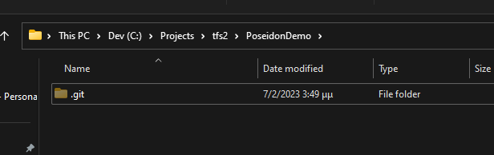
Git basics
Local Repository
A place where your code is being kept and the change history is maintained
A folder acts as a starting point (root) for the repo
A secret folder (.git) inside root maintains needed metadata for tracking changes
Inside root you can add any kind of file or folder
Each developer has a local version (clone)

Slide 7
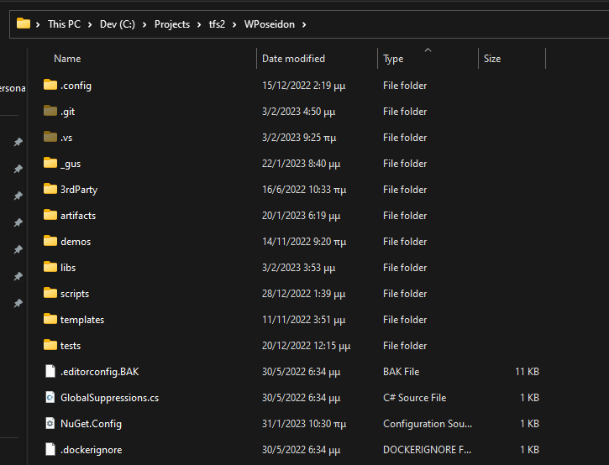
Git basics
Working Directory
Is the contents of the root folder as seen by the filesystem
As the name implies it is “where” work is done

Slide 8
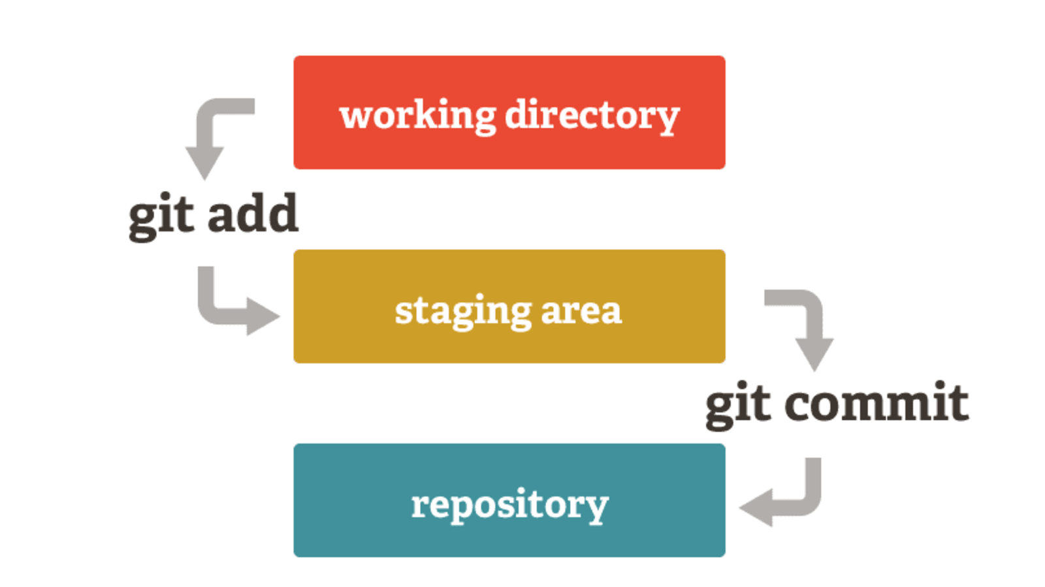
Git basics
Staging Area
is an intermediate area where commits can be formatted and reviewed before completing the commit
possible to quickly stage some files and commit them without committing all modified files in the working directory

Slide 9




Git basics
Remote Repository
Remote repositories are versions of your project that are hosted on the Internet or another network
You can have several of them, each of which generally is either read-only or read/write for you

Slide 10
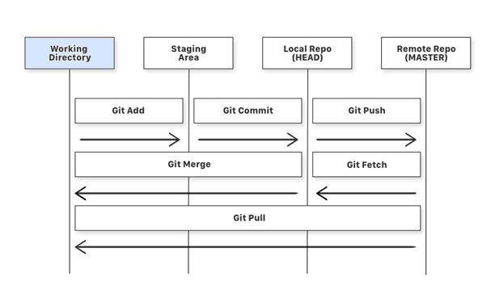
Git basics
Setting up a repo – Git Init
Creates a new Git repository
Used to convert an existing, unversioned project to a Git repository or initialize a new, empty repository.
Most other Git commands are not available outside of an initialized repository

Slide 11
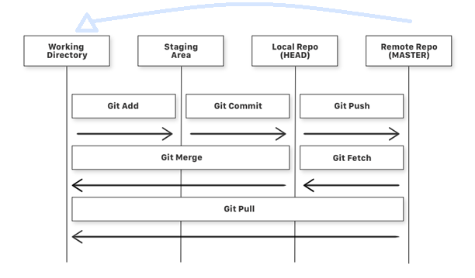
Git basics
Setting up a repo – Git Clone
Used to target an existing repository and create a clone, or copy of the target remote repository

Slide 12
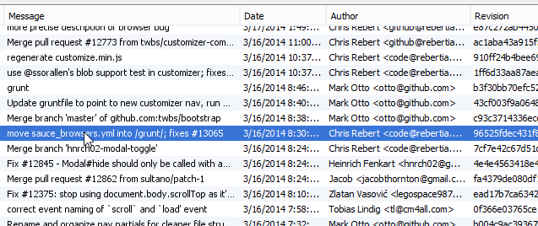
Git basics
Commit
Git takes a snapshot of the project and stores it in the repository along with some other identifying information
The commit object contains information about the directory tree object hash, parent commit hash, author, committer, date and message
Each time we commit, Git records the information above. Thus, we have a highly useful history of the project.
Notes:
Τι είναι το commit
Είναι ένα στιγμιότυπο του project μαζί με έξτρα πληροφορίες όπως η ημ/νία, ο commiter, ένα μήνυνα περιγραφής των αλλαγών καθώς επίσης και ένα αναγνωριστικό hash code.
Με αυτές τις πληροφορίες καταγράφεται η ιστορικότητα του project

Slide 13
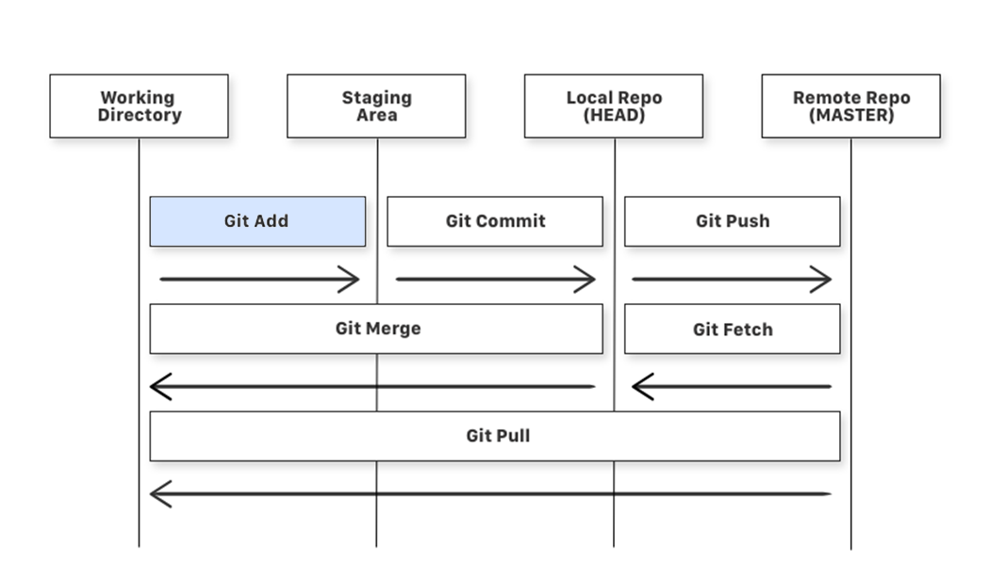
Git basics
Git Add
Used to add a file that is in the working directory to the staging area

Slide 14
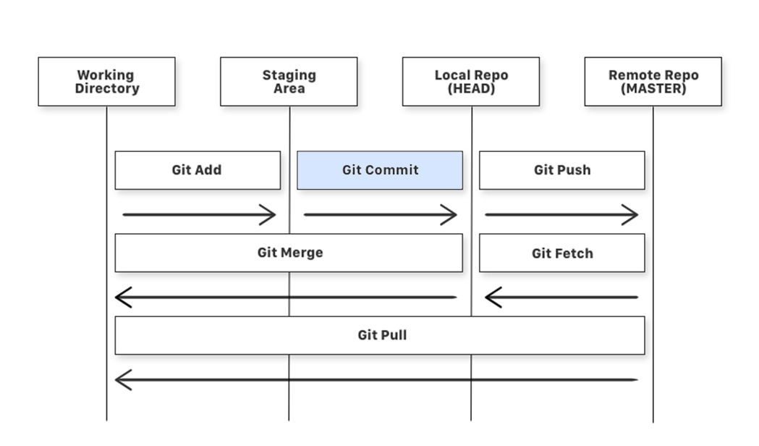
Git basics
Git Commit
Used to add all files that are staged to the local repository

Slide 15
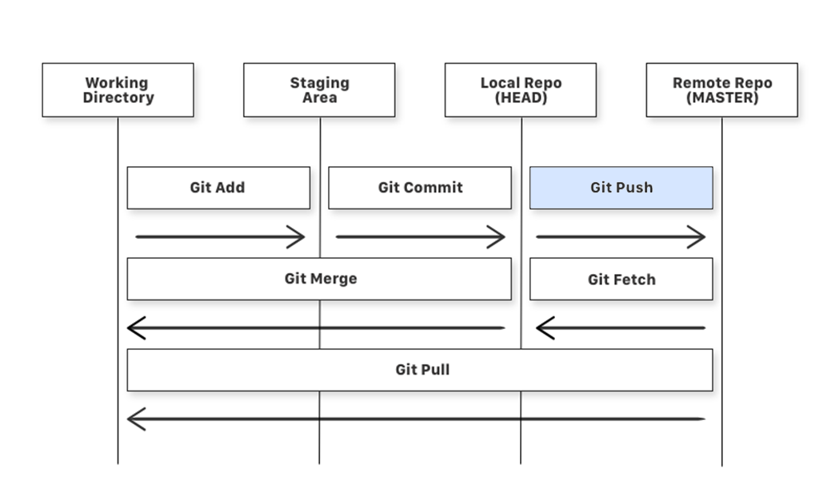
Git basics
Git Push
Used to add all committed files in the local repository to the remote repository

Slide 16
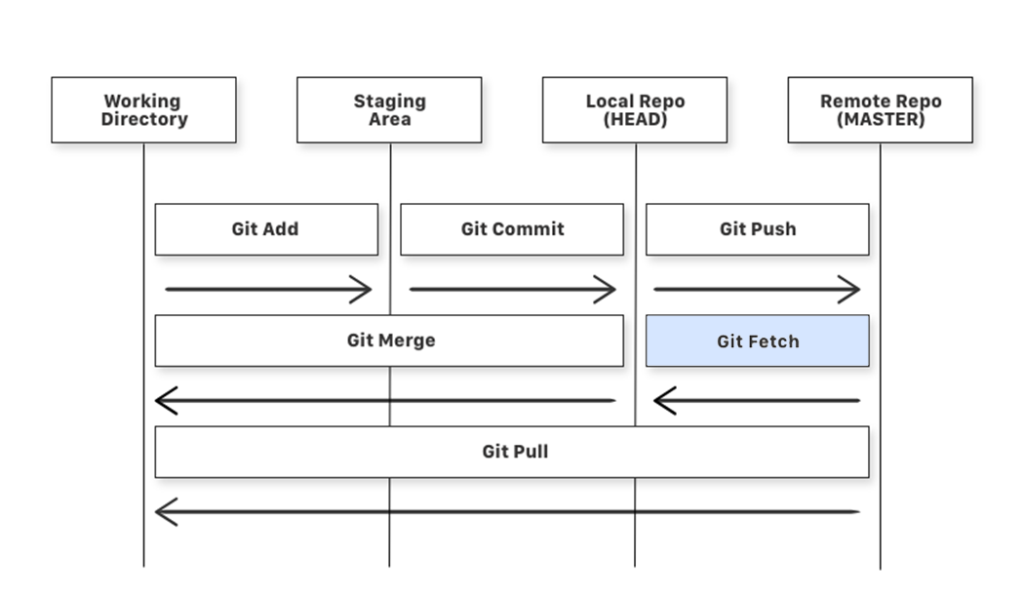
Git basics
Git Fetch
Used to get files from the remote repository to the local repository but not into the working directory

Slide 17
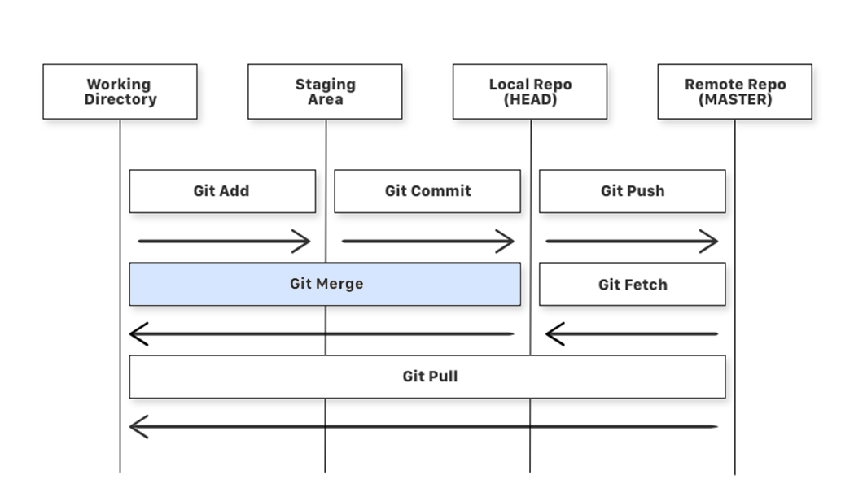
Git basics
Git Merge
Used to get the files from the local repository into the working directory

Slide 18
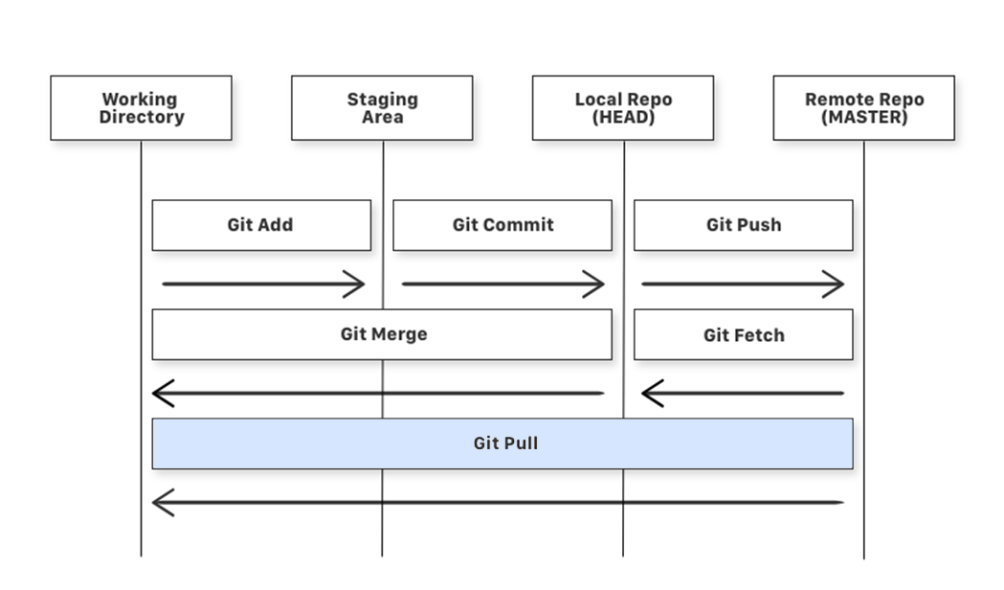
Git basics
Git Pull
Used to get files from the remote repository directly into the working directory. It is equivalent to a git fetch and a git merge

Slide 19
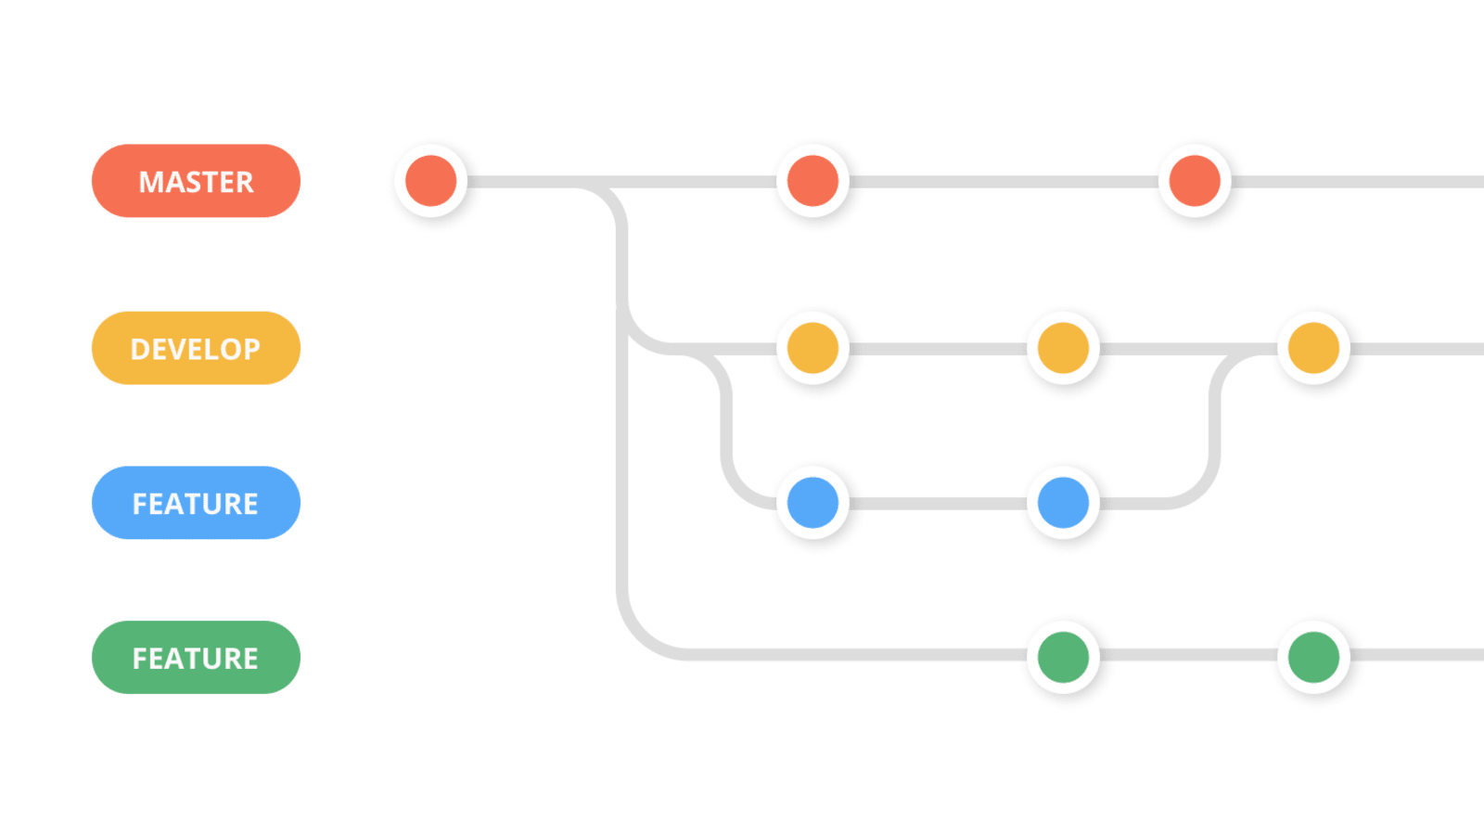
Git basics
Branches
“Simply” a lightweight movable pointer to one of the commits
Think of branches as a way to work on your project by adding a new feature of bug fixes without affecting the master branch

Slide 20

Git basics
Collaborating / Merge
Git merging combines sequences of commits into one unified history of commits
Git can automatically merge commits unless there are changes that conflict in both commit sequences
Notes:
Ωραία φτιάξαμε πολλαπλά branches. Χρειάζεται ένας τρόπος να περάσουμε τις αλλαγές από ένα branch σε ένα άλλο.
Η διαδικασία της ενοποίησης αυτής, ονομάζεται merge.
Σε αυτή την ενέργεια το git, θα “προσπαθήσει” να ενώσει τις αλλαγές στα αρχεία από τα 2 branches.
Υπαρχει όμως η περίπτωση να προκληθούν conflicts.

Slide 21
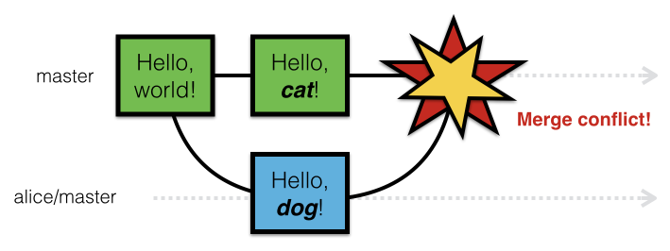
Git basics
Merge Conflicts
Git can automatically merge commits unless there are changes that conflict in both commit sequences
Conflicts generally arise when two people have changed the same lines in a file, or if one developer deleted a file while another developer was modifying it

Slide 22
Git basics
Merge Conflicts
Git can automatically merge commits unless there are changes that conflict in both commit sequences
Conflicts generally arise when two people have changed the same lines in a file, or if one developer deleted a file while another developer was modifying it

Slide 23
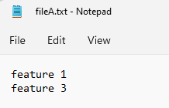
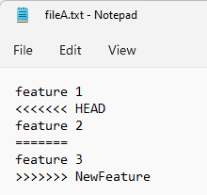
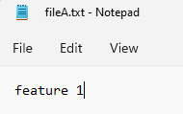
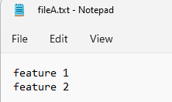
Git basics
Merge Conflict Resolution
Commit B (NewFeature)
Commit A (master)
merge
Commit C (master)

Slide 24
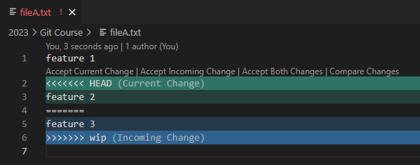
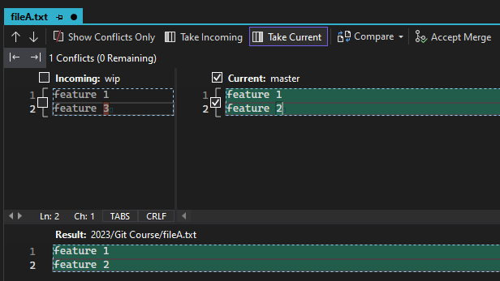
Git basics
Merge Conflict Resolution
Vs Code
Visual Studio

Slide 25
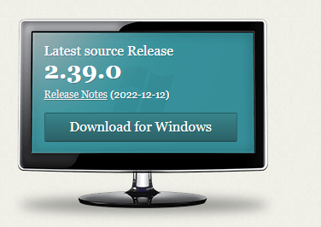
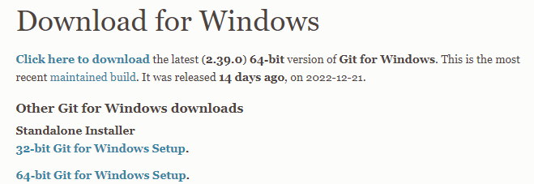
installation
Download Git
https://git-scm.com

Slide 26

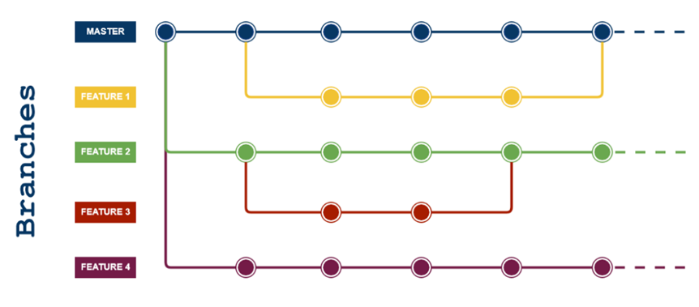
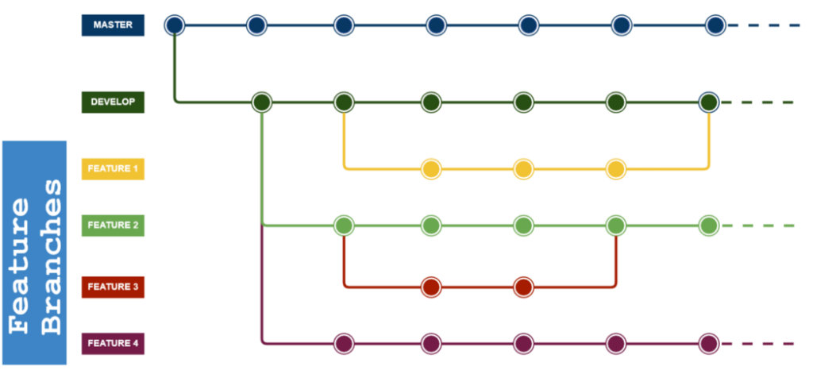
Git workflows
Centralized Workflow
Feature Branch Workflow
GitFlow Workflow
Forking Workflow

Slide 27

Useful links
Git https://git-scm.com
GitHub https://github.com
Workflow https://www.atlassian.com/git/tutorials/comparing-workflows

